Slide 1

Cloud Data Migration
Migration of On-Premise Data from RawDataHub into AWS -DevOps Project
May 2019

Slide 2
Agenda
1
ProSieben DE DevOps Scope
2
Data Sources Priority
3
Sprint Activities
4
Sprint Schedule
5
Team Members
6
Escalation Matrix & Communication Plan

Slide 3
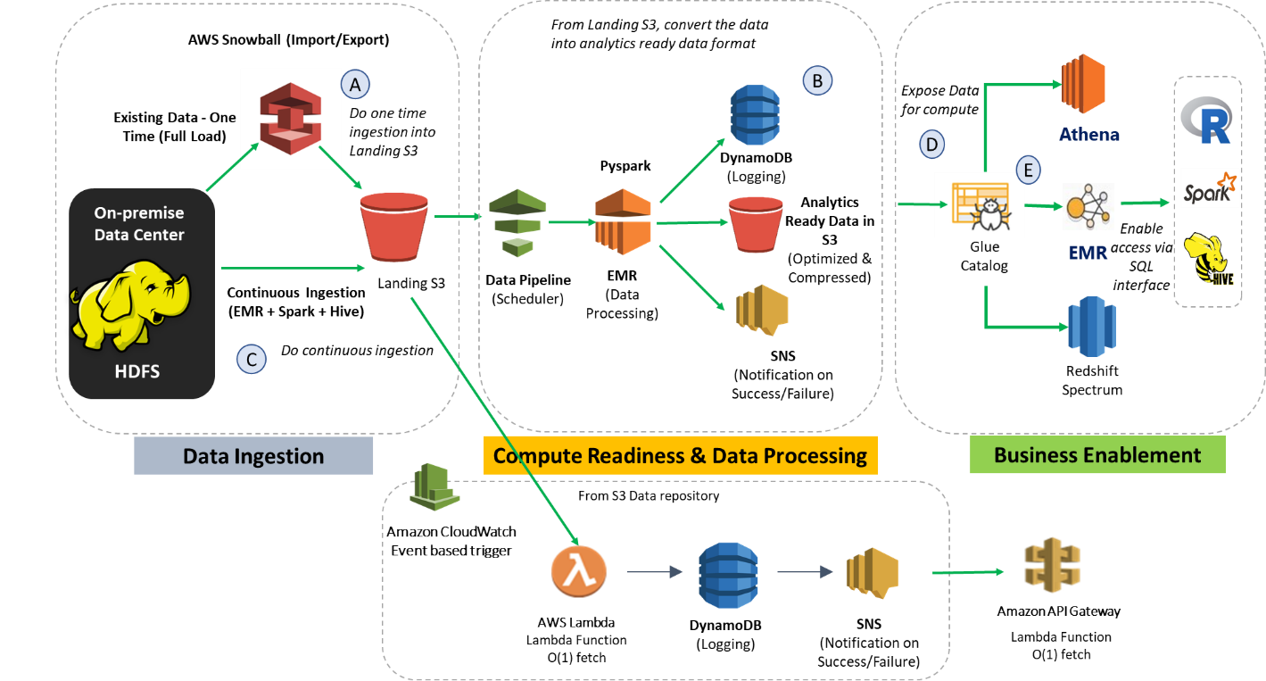
ProSieben Data Engineering DevOps
Scope
Continue to design & extend the S3 based Data lake in AWS in DevOps mode.
Maintain the data model/schema in S3 same as the existing sources in RawDataHub
Build a scheduled, automated continuous ingestion pipeline in AWS.
Extend the existing data consumption layer for Business enablement team and data science team for quick and easy analytics.
S3 architecture shall be based on an understanding of Functional data landscape – RDH and its respective data sources.
Architecture
Notes:
LatentView is a leading global analytics and decision sciences provider, delivering solutions that help companies drive digital transformation and use data to gain a competitive advantage.
With analytics solutions that provide 360-degree view of the digital consumer, fuel machine learning capabilities and support artificial intelligence initiatives., LatentView enables leading global brands to predict new revenue streams, anticipate product trends and popularity, improve customer retention rates, optimize investment decisions and turn unstructured data into a valuable business asset.
LatentView is a trusted partner to enterprises worldwide, including more than two dozen Fortune 500 companies in the retail, CPG, financial, technology and healthcare sectors. LatentView has more than 550 employees in offices in Princeton, N.J., San Jose, Calif., London, Singapore and Chennai, India.
Awards and recognition:
India Emerging 20 (IE20) Award (2016)
Frost & Sullivan Analytics Company of the Year (2015 & 2017)
Deloitte Fast50 (Eight consecutive years, 2009-2016)
Advanced Consulting Partner to Amazon Web Services
Micrsoft Gold Partner in advanced analytics
Gartner Cool Vendor: Advanced Analytics Service Providers for Marketing
Founder Venkat Viswanathan inducted into the Forbes Customer Council

Slide 4
Data Source Priority
Source | Snowball | Hive | Size | Timespan
Adex userrequ | X |  | 24 billion rows per year | 4 Months Minimum
Rest Adex ohne Raw |  | X | Small | Full
TV Schaltplan |  | X | Small | Full
Medialytics Spot KPI |  | X | Small | Full
Wetter_Life |  | X | Small | 12 Months (or complete)
Webtrekk |  | X |  | Fred to clarify about use cases
GA |  | X |  | 2018 until to date

Slide 5
Sprint Activities
Sprint Activities | Frequency
Sprint planning, story grooming, product & sprint backlog creation/update. | Start of Sprint
Daily Operations - Health check, Error reporting, Monitoring. | Daily
Development – Defect fix, Patch fix, Feature development. | Per sprint plan
Release management – Continuous Integration, Code deployment, Patch release, Feature release, Production release | Per sprint plan
Quality Assurance – Code review, Integration testing, Functional testing, UAT. | Per sprint plan
Agile stand-up, Management review meeting, Requirements clarification. | Daily/Weekly/Monthly
One time migration, Scheduled maintenance. | Per the sprint plan
Support – Business requirements, Analytics use cases. | Ad-hoc
Sprint Demo, Sprint Retrospection. | End of Sprint
Requirement Identification
Get the requirement from the business and study the feasibility
Plan for development, Create feature request and backlog entries
Create feature branch, implement new feature on the stack
Business Approval and Production Deployment
Code commit and integration to main branch
Code review & functional testing of the feature developed

Slide 6
Sprint Schedule
AWS Data Platform
Project Start > 06-May-2019
Project End < 31-Dec-2019
Sprint start
Sprint end
Sprint Planning
Health Check / Monitoring / Error Reporting / Agile Stand-up / CI
Feature Development / Defect Fix
Code Review, Functional/Integration Test
Build / Deploy
Sprint Demo
2 Weeks Sprint, 240 story points capacity

Slide 7
Team Members
Role | Location | Number of resources
Principal AWS Consultant | Onsite | Abhineet Basan
Offshore Manager | Offshore | Aravind Devanathadesikan
Technical lead | Offshore | Vikram Santhanam
Analyst | Offshore | Saravanan Ravichandran Dhurga Kuppusami

Slide 8
Escalation Matrix & Communication Plan
Escalation Procedure
First Level | LatentView Project Manager
Provide a single point of contact for day-to-day operational issues Establish communication protocols with client for issue resolution and reporting needs via e-mail, issue log, encounter reports.
Second Level | LatentView Delivery Head
Provide support to the project team throughout all project phases Resolve escalated issues or commit other resources for issue resolution
Third Level | Joint Senior Management of ProSieben and LatentView
In the event of an issue being escalated to this level, the same is resolved in mutual interest and in line with our strategy of ‘Partnership’ with the clients.

Slide 9
Thank You
Email: vijay@latentview.com
Ph: +44 787 9922 849

Slide 10
Appendix

Slide 11
Acceptance Criteria & Milestones
Sprint #1
Sprint #2
On Boarding, Access to ProSieben infrastructure, Business and Technical Orientation for all team members.
Data Discovery - sources, transformations & dependencies, access control policies & data security, S3 file structure based on different data sources and business
Functional & Non-Functional use cases requirements signed off.
Sprint 1 Demo.
Support for One-time data migration using AWS snowball to S3.
Validation of data migrated in to AWS S3 against RawDataHub to ensure migration/replication.
Data pipe line deployed in AWS environment including.
Customized scheduling, monitoring ingestion package based on business need.
Sprint 2 Demo.
Sprint #3
Sprint #4
Optimized S3 data for downstream application consumption.
Sprint 3 Demo.
Optimized data enabled to be accessed via SQL Interface.
Documentation of data migration, data pipeline design, scheduling, monitoring, logging, S3 data optimization.
Sprint 4 Demo.
Acceptance Criteria
Functional & Non-Functional use cases requirements recorded and signed off by stake holders.
Validation report delivered and approved confirming the one-time data migration/replication against RawDataHub.
Scheduled Data pipeline & data lake created, deployed in AWS and approved.
SQL interface developed and deployed in AWS for end user consumption and approved.
Documentation detailing the pipeline design, data refresh process, scheduled ingestion and user instructions, delivered and approved.

Slide 12
Resourcing & Access Matrix
Location | Entity | Data Access | Name | Data Access | Technology components
Onsite | ProSieben | AWS Snowball Personal Architect |  | NA | Yes
 |  | AWS Solution Architect |  | Yes | Yes
 |  | Project Manager | Christian Lueters | Optional | Optional
 | LatentView | Onsite Consultant | Anbarasu | Yes | Yes
 |  | Onsite Architect | Aravind | Yes | Yes
Offshore | LatentView | Offshore Manager | Sathya Moorthy | Yes | Yes
 |  | Offshore Analyst & Senior Analysts |  | Yes | Yes

Slide 13
Snowball Activities
Activities involved in one time migration through Snowball
Snowball Service
AWS personal
AWS hardware
AWS Endpoint & Credentials
Registration of service with AWS
List of sources to be migrated in phase 1
Access to the ProSieben internal data sources, data centre & other infrastructure
Support from LatentView on data migration into AWS hardware
Shipping of the AWS hardware back
Pushing data into AWS S3
Proving AWS end point details & credentials to LatentView

Slide 14











Data & Technology Components
Access to ProSieben Landscape
Data Access
AWS Technology Access
Details of team members working on the project
Availability of LatentView point of contact through out the sprint
Data Access to externals:
FreeIPA generation
Access to Raw data hub
Access to the entire Hadoop infrastructure
Entry Access to externals:
Entry formalities for Aravind
Visa documents for entry into Germany
Raw data hub – All sources
Hue
FreeIPA
Confluence
JIRA
Jupyter Hub
AWS Login Credentials
S3
Snowball
Glacier
Cognito
Lambda
API Gateway
Dynamo DB
Cloud watch
SQS
IAM
Athena

Slide 15
Prerequisites
Snowball
Access to ProSieben Landscape
Registration of service with AWS.
AWS personal
Access to the ProSieben internal data sources, data centre & other infrastructure
Support from LatentView on data migration into AWS hardware
Shipping of the AWS hardware back
Pushing data into AWS
Proving AWS end point details & credentials to LatentView
Details of team members working on the project
Availability of LatentView point of contact through out the sprint
Data Access to externals:
FreeIPA generation
Access to Raw data hub
Access to the entire Hadoop infrastructure
Entry Access to externals:
Entry formalities for Aravind
Visa documents for entry into Germany

